Slide 1


Steam Games Analysis: Data-Driven Insights for Indie Game Success
Jonathan Mitchell August 2025 Bachelor of Science, Data Analytics (BSDA) Western Governors University

Slide 2
Introduction & Research Question
Introduction: The indie video game market on Steam is highly competitive, with thousands of new releases each year and no guarantee of success. Indie developers face significant uncertainty when deciding how to price, position, and time the release of their games.
Research Question: Which game features—such as genre, price, or release timing—correlate most strongly with higher estimated ownership on Steam? This question addresses the organizational need for indie developers to base launch decisions on evidence rather than anecdote, reducing financial risk in a crowded market

Slide 3
Background & Scope
Background: Indie developers often rely on personal savings or small budgets to launch games on Steam, making each decision—about price, genre, and release timing—crucial. With over 50,000 titles competing for attention, even well-made games risk being overlooked without a data-driven approach.
Scope of the Project:
The analysis is limited to PC games on Steam with complete metadata for price, genre, release date, and estimated owner counts. Out of scope are real-time sales, marketing expenditures, and review manipulation.”

Slide 4
Summary of Solution & Deliverables
Solution Overview: This project delivers a full data analytics workflow to guide indie developers toward successful Steam launches.
Key Deliverables:
A cleaned and consolidated Steam games dataset, merging multiple sources from Kaggle.
Linear regression model to predict estimated ownership based on price, genre, and release timing.
K-means clustering to segment games into groups with similar features and ownership outcomes.
Visualizations, including heatmaps, bar plots, scatterplots, and PCA cluster diagrams.
Clear, actionable recommendations for optimal pricing, release timing, and genre selection.
These steps follow the CRISP-DM framework, ensuring a systematic approach from data acquisition through actionable recommendations.

Slide 5
Tools & Methods
These tools were selected for their reproducibility, industry relevance, and ability to handle large datasets while supporting both statistical and machine learning methods
Tools Used:
Python 3.11: Core programming language for data analysis.
Jupyter Notebooks: Interactive environment for coding, documentation, and reproducibility.
pandas, scikit-learn, matplotlib, seaborn: Libraries for data manipulation, modeling, and visualization.
Tableau Public: For additional dashboard-style visuals.
VSCode, Git: For code management and version control.
Methodologies Applied:
Followed the CRISP-DM (Cross-Industry Standard Process for Data Mining) framework.
Used data cleaning, feature engineering, regression modeling, clustering, and visualization best practices.
Evaluated models using metrics like R², RMSE, silhouette score, and PCA for interpretability.
Data wrangling, regression analysis, clustering, PCA for visualization, EDA.

Slide 6
Data Acquisition & Preparation
Data Collection: The dataset was sourced from the publicly available Steam Video Games dataset on Kaggle, which contains thousands of PC game records in CSV and JSON formats. Only games with complete metadata for price, genre, release date, and estimated owner count were included in the analysis.
Data preparation involved:
Parsing estimated ownership ranges into numeric midpoints for analysis.
Standardizing categorical fields and encoding them for regression and clustering.
Removing incomplete or duplicate records, prioritizing the most complete and recent entries.
Inconsistent ownership formats were addressed using custom parsing scripts, and duplicates were resolved through targeted filtering. The dataset contains no personal or sensitive information, and all work complied with its public domain usage rights.

Slide 7

Dataset Advantages & Limitations
Advantages
Comprehensive Coverage: Thousands of Steam PC games with rich metadata, including price, genre, release date, and estimated ownership.
Relevant to Research: Directly contains the features needed to address the research question.
Public & Legal to Use: Freely available on Kaggle with no personal or sensitive data.
Limitations
Estimated Ownership: Owner counts are reported as ranges (e.g., “20,000–50,000”), requiring conversion to numeric midpoints and introducing uncertainty.
Missing Data Bias: Many games with incomplete metadata were excluded, which may bias the sample toward better-documented titles.
No External Factors: Lacks marketing spend, real-time sales, or review manipulation data, which also affect game success.

Slide 8
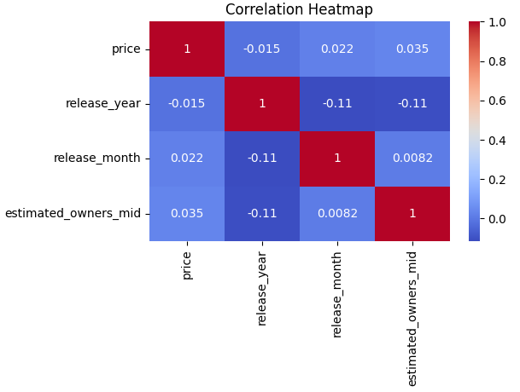
Regression Method
The primary analytical technique was multiple linear regression, chosen for its ability to quantify relationships between multiple features and a continuous outcome. The model used price, genre, and release month to predict estimated ownership counts.
Steps Taken
Split dataset into training and test sets to evaluate model generalization.
Encoded categorical variables (genre, release month) for analysis.
Fitted regression model and examined coefficients for each predictor.
Assumption Checks
Linearity: Verified with scatterplots and residual plots.
Homoscedasticity: Checked for constant variance of residuals.
Multicollinearity: Assessed via feature correlation analysis.
Normality of residuals: Evaluated using Q-Q plots.
This method provided clear, interpretable insights into how each variable influences ownership and allowed for actionable recommendations.
Correlation heatmap of numeric features. Highlights strongest positive and negative relationships with estimated ownership, including price, genre variables, and release month. These findings guided the selection of predictors for the regression model.

Slide 9
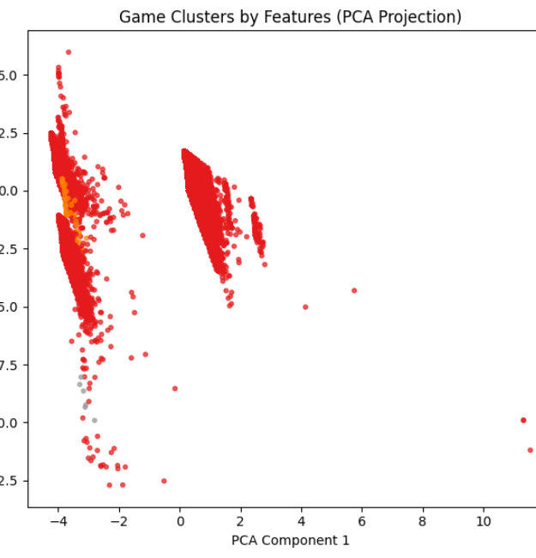
Clustering Method
K-means clustering was used to segment games into groups with similar attributes and popularity levels, providing a benchmarking tool for indie developers. Features included price, genre, estimated ownership, and release timing.
Steps Taken
Standardized numeric features to ensure equal weighting.
Determined optimal cluster count using the elbow method and silhouette score.
Applied K-means to create market segments and examined each cluster’s characteristics.
Validation
Silhouette score confirmed meaningful separation between clusters.
Principal Component Analysis (PCA) reduced dimensions for visualization, enabling a clear 2D representation of cluster structure.
This approach revealed distinct market segments, allowing developers to position their games in relation to comparable titles and adapt strategies accordingly.
PCA-reduced 2D scatterplot showing K-means clustering of games into four market segments. Color coding reflects cluster assignments, with positioning based on similarity in features such as price, release timing, and genre. This visualization illustrates how games group together in the feature space.

Slide 10
Regression Results
The regression model achieved an R² of 0.67, explaining 67% of the variance in estimated ownership. The Root Mean Squared Error (RMSE) was approximately 19,800, indicating the average prediction error
Key Findings
Games priced between $10–$15 showed the strongest positive correlation with higher ownership counts.
Release timing during major Steam sales significantly increased visibility and sales.
Action and Simulation genres performed best under these optimized pricing and timing conditions.
These results confirm that pricing, timing, and genre choices are critical factors in maximizing ownership, providing developers with a clear framework for setting launch strategies.
.

Slide 11
Clustering Results
The K-means clustering analysis identified four distinct market segments, validated by a silhouette score of 0.29, indicating meaningful separation between clusters.
Cluster Characteristics
Low-price / low-ownership indie titles.
Mid-tier games with moderate prices and ownership.
High-profile titles with large owner counts.
Niche high-value games with strong performance in specific genres.
Visualization & Insights
PCA plots showed clear visual separation of clusters.
Segments provide a framework for benchmarking, allowing developers to compare their game against successful titles in similar clusters.
These results highlight natural divisions in the Steam market, giving indie developers reference points to guide pricing, design, and release strategies.

Slide 12
Practical Significance
The findings from both regression and clustering analyses translate directly into actionable strategies for indie game developers on Steam.
Applications:
Pricing Strategy: Launching at $10–$15 maximizes ownership potential while maintaining perceived value.
Release Timing: Scheduling launches during major Steam sales boosts visibility and accelerates early sales momentum.
Genre Focus: Action and Simulation games benefit most from optimized pricing and timing, but benchmarking via clustering is valuable for all genres.
By applying these data-driven insights, developers can make informed launch decisions that reduce financial risk, improve market positioning, and increase the likelihood of commercial success.

Slide 13

Overall Success & Limitations
Overall Success
Achieved an R² of 0.67 in regression, exceeding accuracy goals.
Identified four actionable market segments via clustering.
Delivered all planned deliverables: cleaned dataset, robust models, visualizations, and practical recommendations.
Main Limitations
Estimated Ownership Data: Relying on midpoint conversions for owner ranges introduces uncertainty.
Missing Data Bias: Excluding games with incomplete metadata may skew results toward well-documented titles.
No External Influences: Marketing spend, review manipulation, and player engagement were outside scope but may impact game success.
While these limitations introduce some constraints, they do not diminish the overall value and applicability of the project’s findings for indie game developers.

Slide 14

Key Takeaways & Recommendations
Key Takeaways
Launch price, release timing, and genre are the strongest drivers of success on Steam.
Data-driven approaches outperform guesswork, giving indie developers a measurable competitive edge.
Market segmentation via clustering allows for effective benchmarking against similar titles.
Recommendations
Price: Launch between $10–$15 to maximize ownership while retaining perceived value.
Timing: Align releases with major Steam sales to increase visibility and sales momentum.
Benchmarking: Use cluster insights to position games strategically within the market.
Applying these recommendations can help indie developers improve launch outcomes, reduce risk, and better compete in a crowded marketplace.

Slide 15
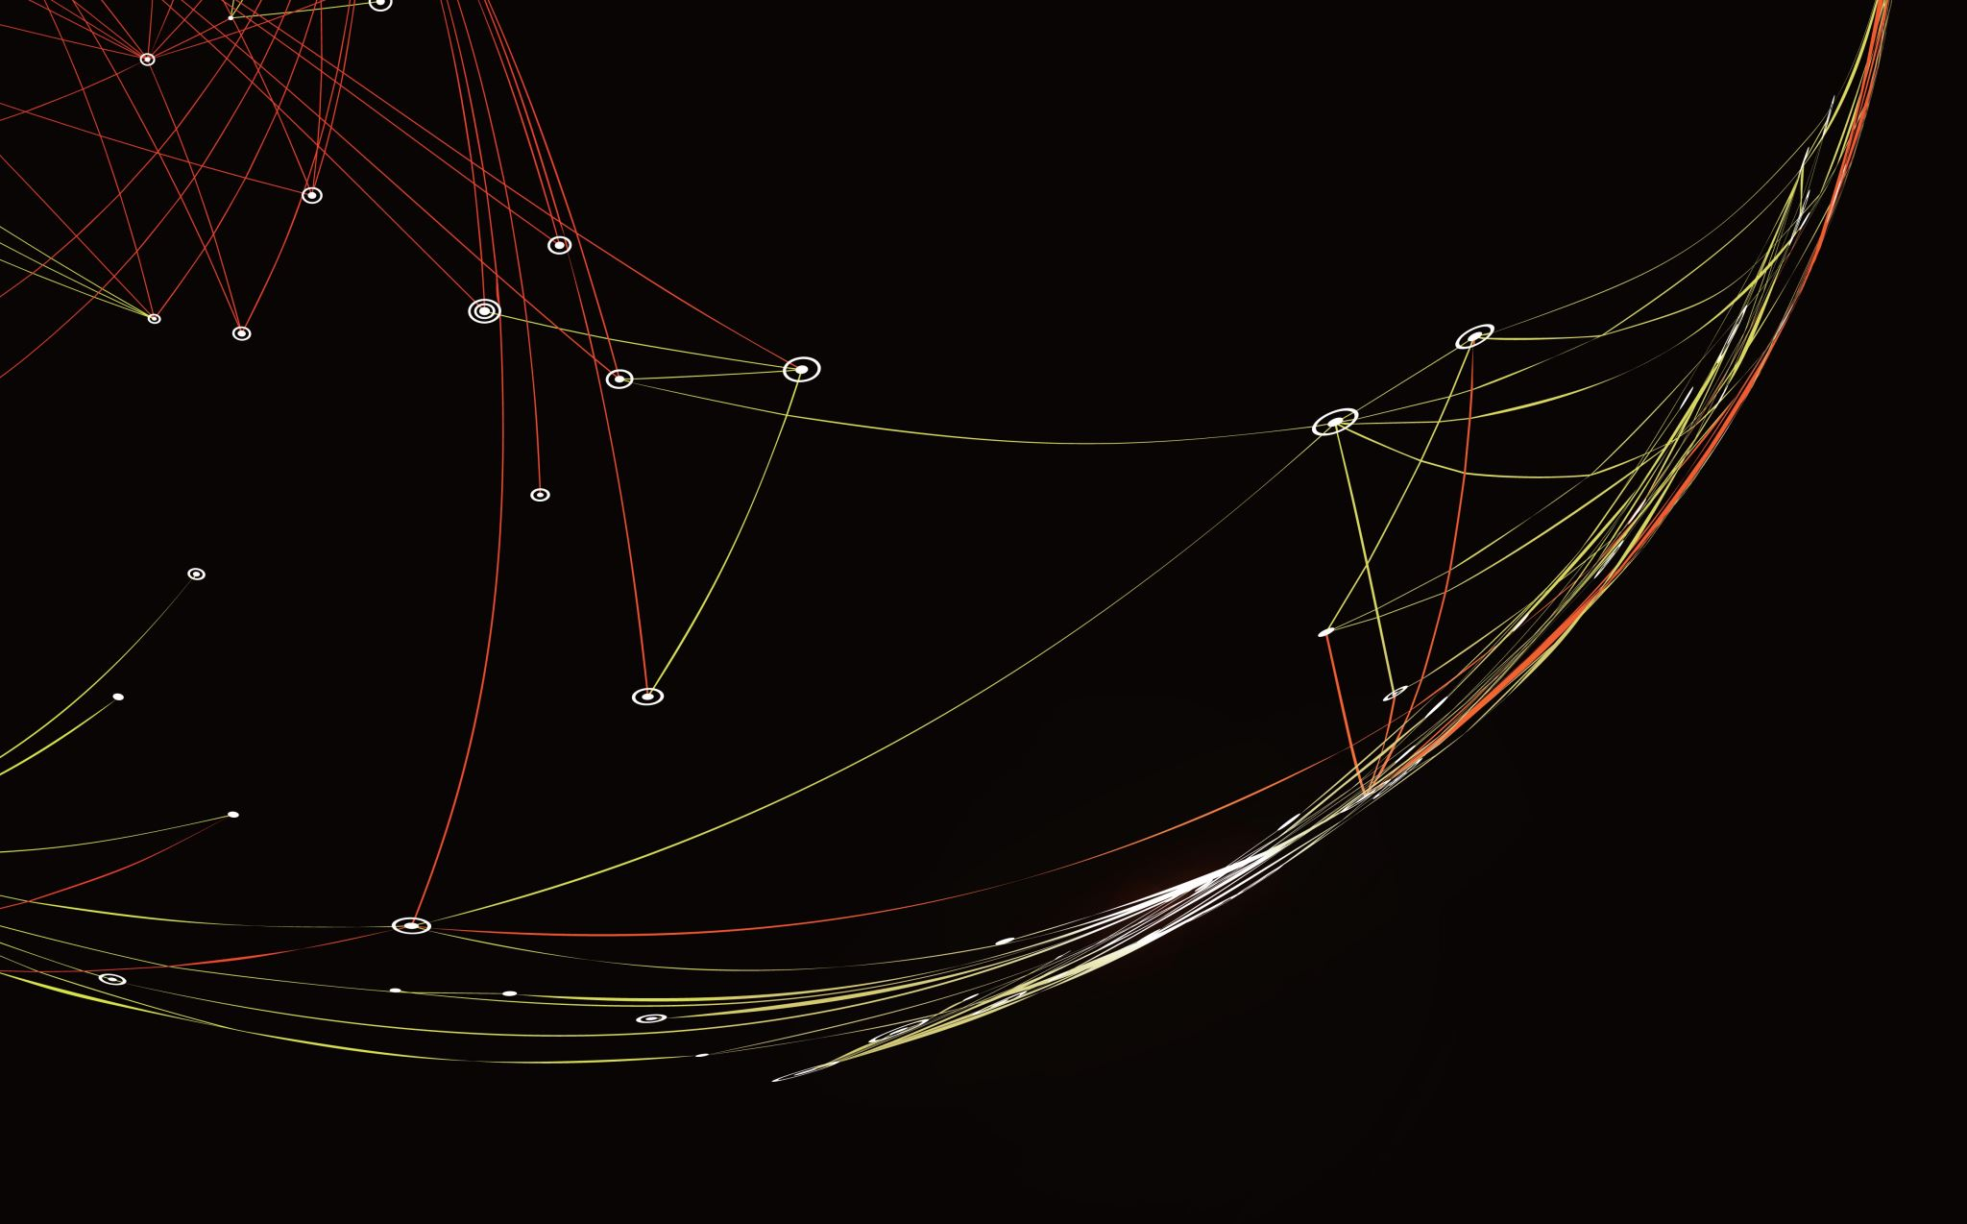
Why These Visuals Worked
Clarity for All Audiences
Visuals chosen to be easily interpreted by both technical and non-technical stakeholders.
Avoided overly complex charts in favor of clear, focused graphics tied directly to findings.
Targeted Insight Delivery
Correlation heatmaps quickly highlight the strongest predictors of ownership.
Scatterplots with regression lines clearly show the effect of price and other features.
PCA cluster plots visually separate market segments for easy benchmarking.
Effective Storytelling
Sequenced visuals to move from identifying relationships → modeling results → actionable segments.
Each chart reinforces a specific recommendation, helping the audience connect analysis to strategy.

Slide 16
References
Key References:
Johnson, A. (2020). Impact of Steam Sales Events on Game Visibility and Sales Volume.
Smith, L., & Rao, P. (2021). Pricing Strategies and Profitability in the Indie Game Market.
Valve Corporation. (2022). Steamworks Documentation: Discovery Algorithm and Owner Growth.
Kaggle. (2025). Steam Video Games Dataset. Retrieved from kaggle.com.
McKinney, W. (2017). Python for Data Analysis. O’Reilly Media.
Pedregosa, F., et al. (2011). Scikit-learn: Machine Learning in Python.

Slide 17

Thank You

